Slide 1
ICA ELEMENTS FOR REDUCING CHINOOK SALMON BYCATCH AT ALL ENCOUNTER LEVELS
HOT SPOT CLOSURE PROGRAM
INDIVIDUAL BYCATCH LIMITS
MARKET BASED INCENTIVES

Slide 2
ICA requirements to participate in the 68,392 hard cap scenario
(as specified in the PPA)
An ICA must provide incentive(s) for each vessel to avoid salmon bycatch under any conditions of pollock and salmon abundance in all years
Incentive measures must include rewards for salmon bycatch avoidance and/or penalties for failure to avoid salmon bycatch at the vessel level.

Slide 3
ICA requirements to participate in the 68,392 hard cap scenario
(as specified in the PPA)
The ICA must specify how those incentives are expected to promote reductions in actual individual vessel bycatch rates relative to what would have occurred in absence of the incentive program. Incentive measures must promote salmon savings in any condition of pollock and salmon abundance, such that they are expected to influence operational decisions at bycatch levels below the hard cap.

Slide 4
PPA Incentive Requirements
Provide incentives at the individual vessel level
Incentivize vessels to avoid Chinook bycatch at all levels of abundance in all years
Reward vessels that successfully avoid Chinook and/or penalize vessels that fail to avoid Chinook
Incentives must influence fishing decisions at levels below the hard cap

Slide 5
Three point plan for meeting the criteria required in the PPA
HOT SPOT CLOSURE PROGRAM
INDIVIDUAL BYCATCH LIMITS
MARKET BASED INCENTIVES

Slide 6
Hot Spot Closure Program
Two Types of Closures
  Fixed Closure Area in the A Season
  Rolling Closures for Both A and B Seasons

Slide 7
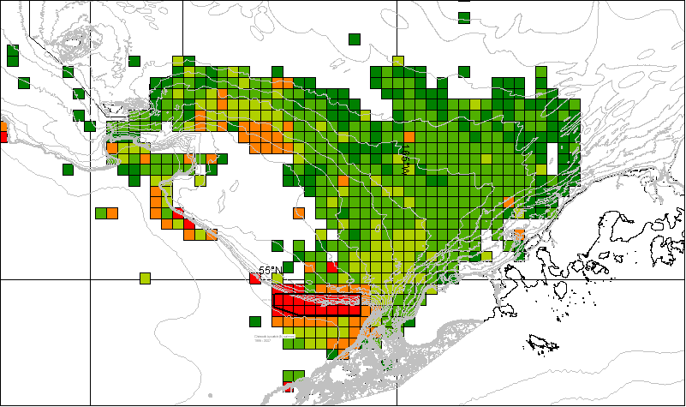
Fixed Closure Area - A Season
The “consistently hot” hot spot; increases area available for rolling hot spot closures.
Fixed closure area as implemented for the 2008 A season – Area based on Chinook bycatch 1995-2007

Slide 8
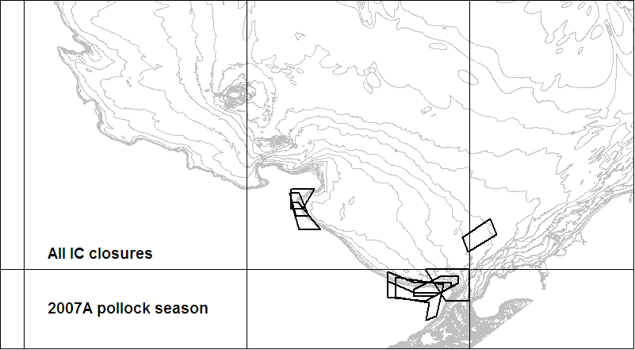
IC salmon closures, 2007 A

Slide 9
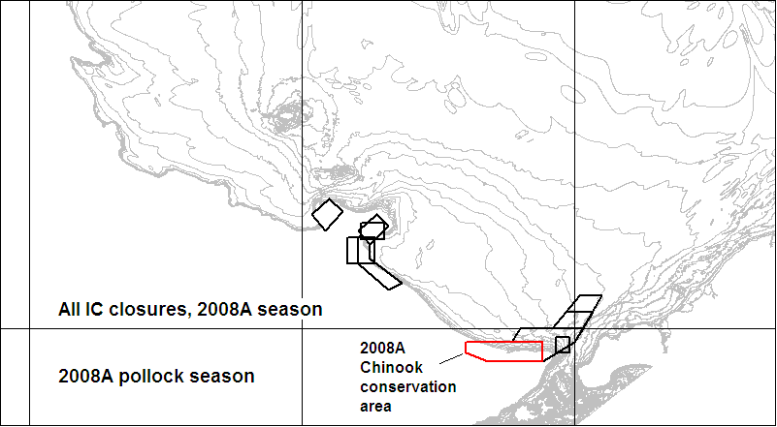
IC salmon closures, 2008A (red is Chinook fixed closure area)

Slide 10
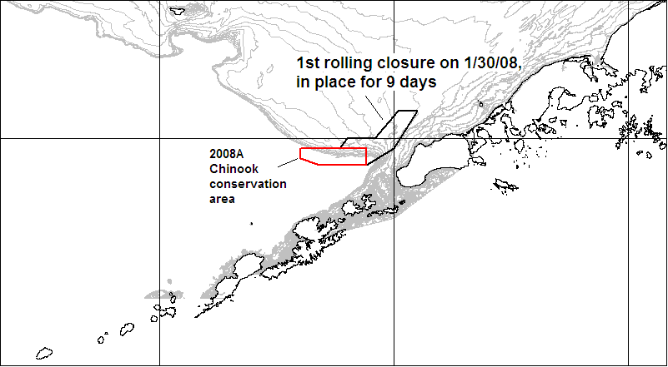
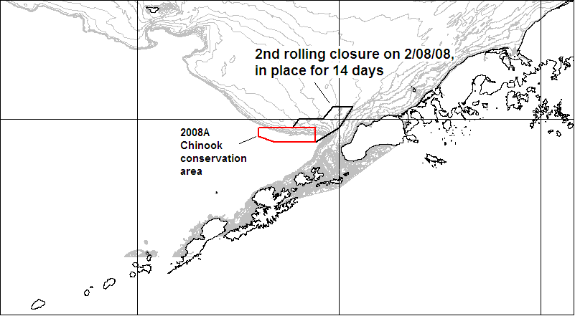
Rolling Closures for Both A and B Seasons

Slide 11
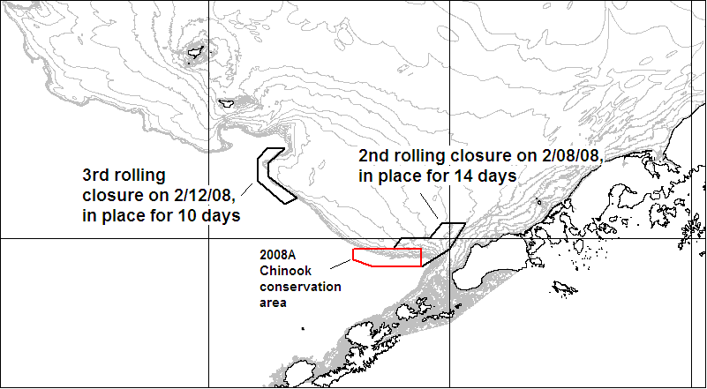
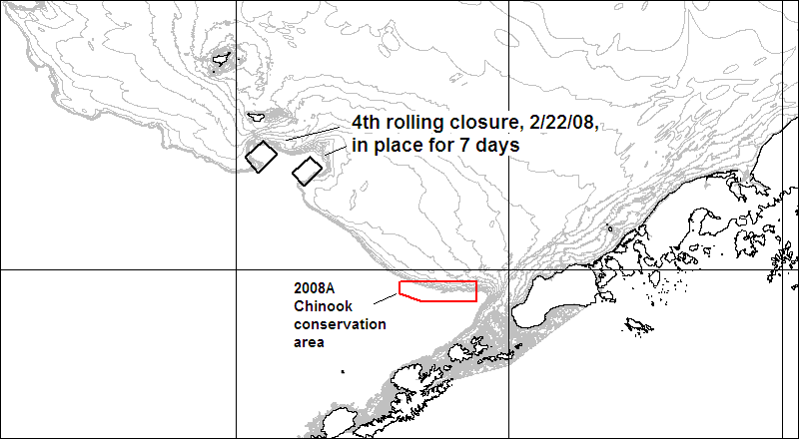
Rolling Closures for Both A and B Seasons

Slide 12
Hot Spot Closures and the PPA Incentive Requirements
Fixed and rolling hot spots are not an incentive based program, but work well in conjunction with incentive programs
  Fixed and rolling closures reduce the fleet-wide bycatch of Chinook Salmon in all levels of abundance
  Information provided by hot spot closures inform fishermen of current bycatch conditions and trends
  This information will be one of the most important tools for successful incentive programs

Slide 13
Improving the Current Hot Spot Closure Program
Shift from cooperative based closures to finer scale closure assignments.
  C/P and inshore vessels are assigned individual tier levels
  Mothership catcher vessels are assigned tier status at the mothership fleet level.
    3 mothership operations = 3 fleet tier assignments independent from each other
Individual Vessels with higher bycatch will no longer fish under the cover provided by lower bycatch vessels in the same cooperative

Slide 14
INDIVIDUAL BYCATCH LIMITS
Sector and Inshore Coop allocations taken to the individual vessel level
All vessels are allocated an individual amount of salmon encounter credits
Vessels must stop fishing before exceeding their available salmon encounter credits

Slide 15
Sector and Inshore Coop allocations taken to the individual vessel level
  Individual vessel Incentives start with individual vessel responsibilities created by vessel level bycatch limits
  No cover provided for individuals with high bycatch
  Fishermen must make operational decisions at bycatch levels below the hard cap

Slide 16
All vessels are allocated an individual set of salmon credits
  First Year Example: (done pro rata to pollock )
    An Inshore Cooperative is allocated a bycatch limit of 2,900 Chinook salmon for the upcoming A season.
    The coop has agreed that Vessel A has access to 9% of the coop’s pollock allocation
    Vessel A is provided an individual bycatch cap of 261 credits – 9% of the coop’s 2,900 bycatch limit

Slide 17
All vessels are allocated an individual set of salmon credits
Vessels will hold on to their credits until they absolutely don’t need them to harvest their pollock
Vessels may hang on to unused credits to create an opportunity to harvest additional pollock
Stranding of unused credits will occur each year
Stranding results in an unrealized bycatch level well below the hard cap.

Slide 18
Vessels must stop fishing before exceeding their available salmon credits.
Vessels with exhausted salmon credits have a limited set of options:
Find additional salmon credits from another vessel, if and when they become available
Allow another vessel(s) with available credits to harvest uncaught pollock
Forgo the harvest of their pollock

Slide 19
MARKET BASED INCENTIVES
Legacy Program – Create forward looking incentives to reduce by-catch this year by rewarding and penalizing vessels through subsequent annual credit allocations, effective at all levels of abundance
Incentives created by trading mechanisms
“Market Based Incentives” = economic incentives.

Slide 20
Legacy Program
Subsequent Credit Allocation Adjustments Based on Vessel By-catch Avoidance Record
  EXAMPLE:
    Year 1 – Each vessel receives salmon credits pro rata to their pollock allocation (previous example)
    Year 2 and each year thereafter each vessel receives salmon credits based on 3 criteria:
      1/3 based on vessel’s original pro rata allocation
      1/3 based on vessel’s previous year’s allocation
        -creates CUMULATIVE record of behavior.
      1/3 based on vessel’s previous year relative bycatch performance
Notes:
John, I added -creates cumulative record…

Slide 21
Legacy Program
Subsequent Credit Allocation Adjustments
  Individual vessel incentives
    Every vessel’s future allocation of credits at risk of being reduced regardless of the number of salmon taken
    Creates behavior that will conserve available credits due to unknown future needs
    Rewards the best performing vessels with additional future bycatch credits
    Penalizes poor performing vessels by reducing future bycatch credits
    Incentive strongest during low encounter years

Slide 22
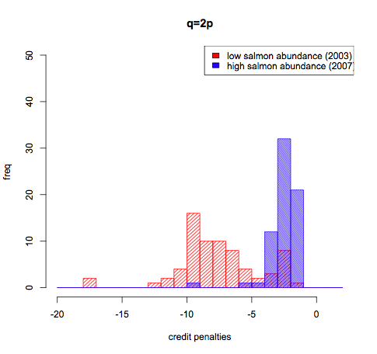
Legacy Program
Individual vessel incentives
Every vessel’s future allocation of credits is at risk of being reduced if their relative performance is poor. This penalty is greater during low salmon abundance years.
Notes:
John, You may or may not want to use this slide. It shows bigger penalties per additional salmon caught during times of low salmon abundance.
The graph is for the inshore fleet. If we take one vessel at a time, and add 10 more chinook to their actual record in 2003 (red) and do the same in 2007 (blue) we can see that times of low salmon abundance carry higher penalties in next year’s allocations. This example using the by-catch penalty function q=2pi, that gives a range of (0.5, 1.5) in asymptotic credit allocation difference from the initial allocation. (that is, here if you have a consistently poor record, you can loose up to 50% of your original starting proportional allocation).

Slide 23
Trade Generated Incentives
Vessels may need credits beyond their allocation to harvest their pollock for a variety of reasons, some beyond their control. They are provided the opportunity to acquire additional credits, but have to make several difficult choices:
1. Securing additional credits is expensive
2. Securing additional credits does not guarantee the harvest of their remaining pollock
3. Catching the additional bycatch may result in a reduced allocation in the following year unless they fish cleaner

Slide 24
Trade Generated Incentives
The result of trading are:
Strong incentives to fish clean in order to be a seller, not a buyer, of credits.
Buyers may be doubly penalized by the cost of buying additional credits and the reduction of future allocations under the Legacy Program
Creates an “out” for unfortunate bycatch circumstances

Slide 25
Program Summary
Hard Cap – Sets upper limit on Chinook bycatch
Hot Spot Closures – Reduces Chinook bycatch at all levels of abundance
Individual Bycatch Limits
    Individual vessel responsibilities and incentives
    operational decisions at bycatch levels below the hard cap
    Results in realized bycatch levels below the hard cap
Market Based Incentives – Rewards and penalizes vessels at all levels of Chinook abundance

